Slide 1
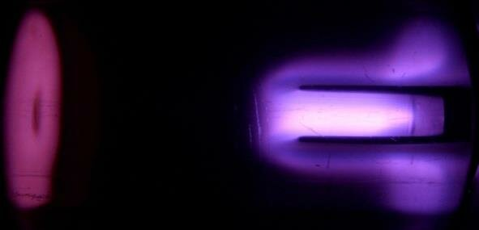
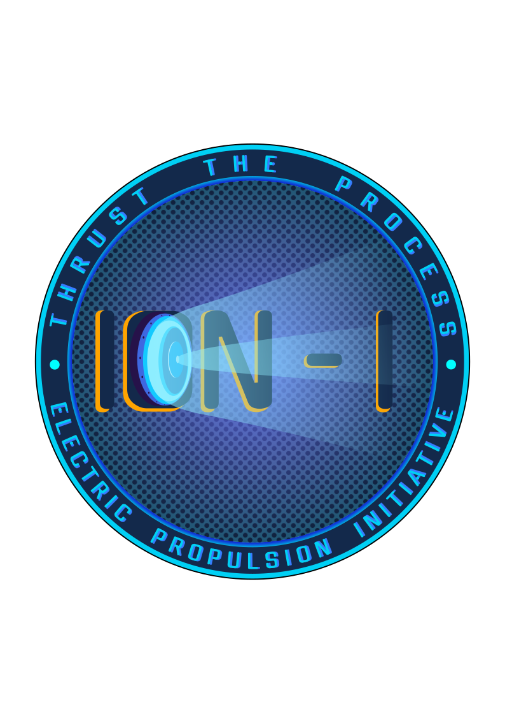

Slide 2
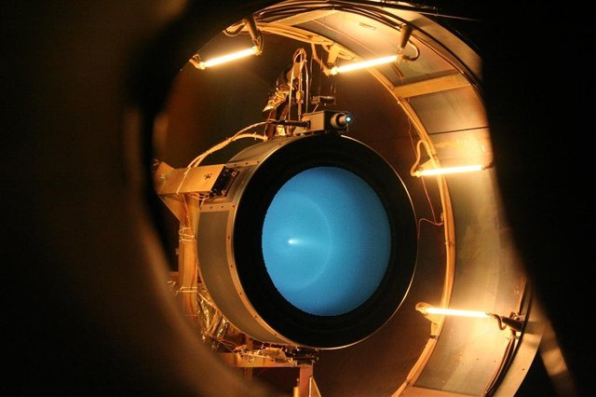

Agenda
Intro
Plasma Chamber
Goals
Timeline
Things to Do

Slide 3


Intro
Electric Propulsion Initiative - ION-I
Working with plasma generation subteam
Join if interested（https://join.slack.com/t/ion-i/shared_invite/zt-3rffsnr77-Z9qhdtawae_0rm4HZCqmng）
Visualization in Python
Simulation still in progres
Particle Dynamics, Electric Field
Present in EOH/PECI; Publications
Github （github.com/quyaoning/Plasma-Visualization)
Meeting Time
03/03/2026
1

Slide 4
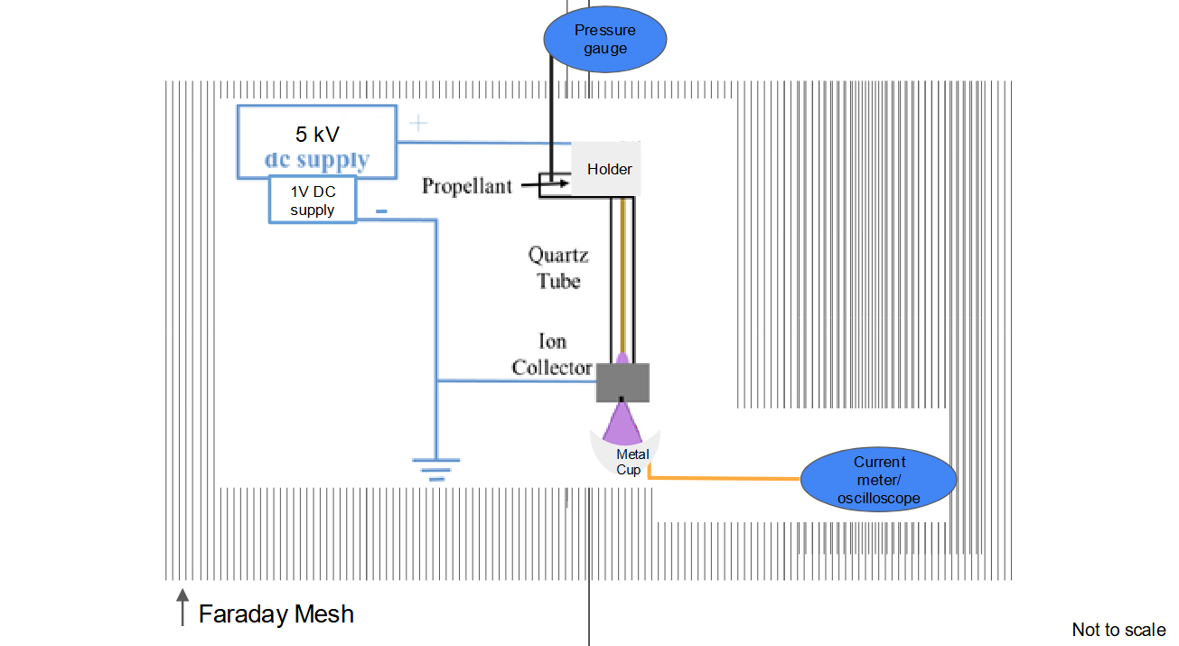
Plasma Chamber
Electric Propulsion Initiative - ION-I
1

Slide 5
Goals
Electric Propulsion Initiative - ION-I
Dynamics in the Quartz Tube
3D cylinder view, gif/video
Particle Trajectory and State (Argon Ionization)
Electric Field
Inputs: Position, Particle Type, Field Vector, Time
From a txt/json/csv file, TBD
Interactive Website
03/03/2026
1

Slide 6
Timeline
Electric Propulsion Initiative - ION-I
Toolkit Decision
Interactive Features
Rendering
Dataset Ready
03/7/26
03/28/26
03/14/26
04/04/26
Basic Visualization
Web Integration, Final Review
03/03/2026
1

Slide 7
Things to Do
Electric Propulsion Initiative - ION-I
Look into Visualization Toolkits
Data Make-up
Distribution and Tragectory (Consider Field)
Argon Ionization Time (probability density function of time)
Electron Field Vectors
03/03/2026
1

Slide 8
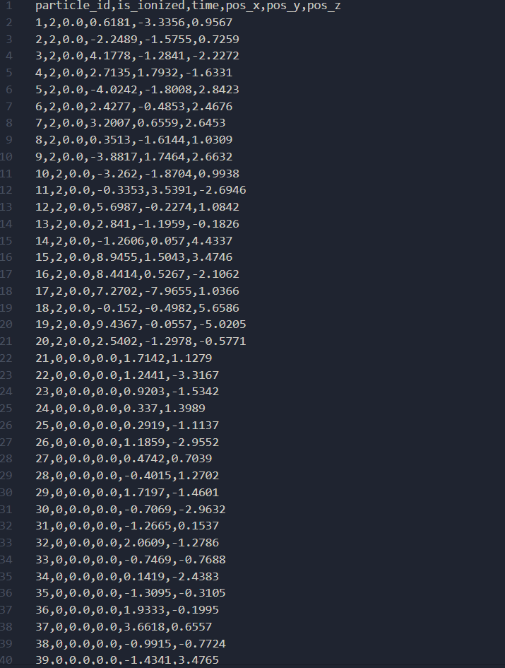
Dataset
Electric Propulsion Initiative - ION-I
CSV File
Stepped Time
Particle type
Position
1

Slide 9
Things to Do
Electric Propulsion Initiative - ION-I
Toolkit selection
Plotly, PyVista, Vispy, VPython, Mayavi, Matplotlib
Data Mapping
Cylinder Geometry
Distinguished particle types
Particle trajectory
1

